Slide 1
Water induced Restructuring of Vanadia clusters supported on a-TiO₂ (101) hydration dynamics

Slide 2
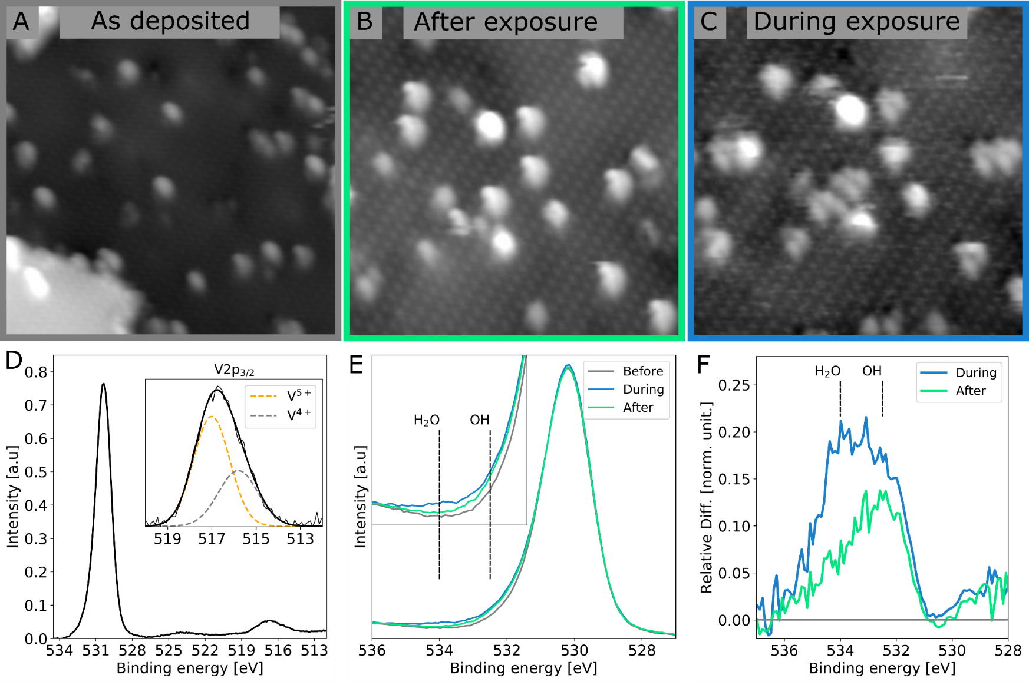
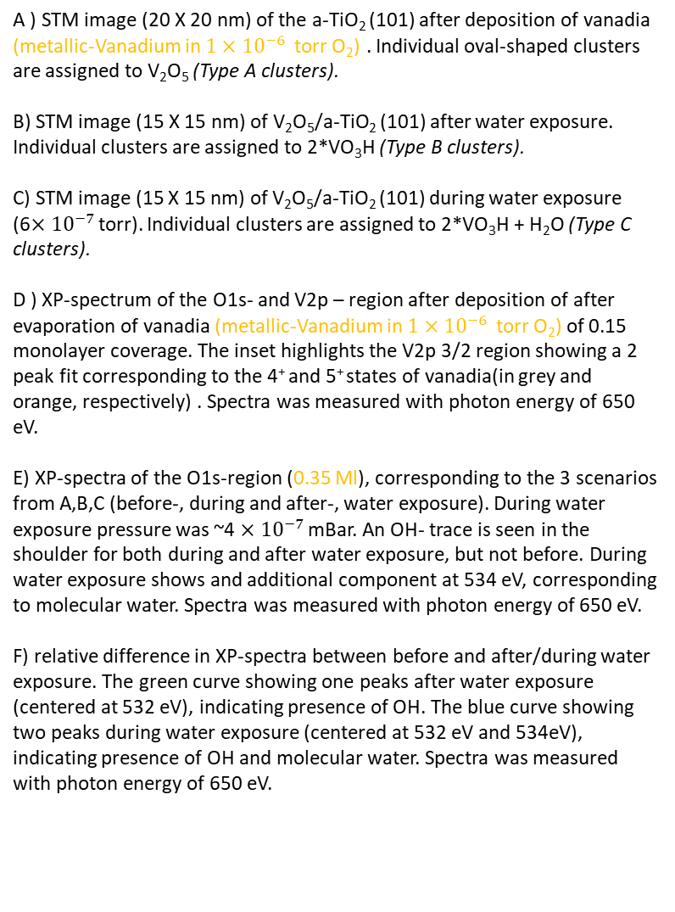
Figure 1, overview
A ) STM image (20 X 20 nm) of the a-TiO₂ (101) after deposition of vanadia (metallic-Vanadium in $1×{10}^{−6 }$ torr O₂) . Individual oval-shaped clusters are assigned to V₂O₅ (Type A clusters).
B) STM image (15 X 15 nm) of V₂O₅/a-TiO₂ (101) after water exposure. Individual clusters are assigned to 2*VO₃H (Type B clusters).
C) STM image (15 X 15 nm) of V₂O₅/a-TiO₂ (101) during water exposure (6$×{10}^{−7 }$torr). Individual clusters are assigned to 2*VO₃H + H₂O (Type C clusters).
D ) XP-spectrum of the O1s- and V2p – region after deposition of after evaporation of vanadia (metallic-Vanadium in $1×{10}^{−6 }$ torr O₂) of 0.15 monolayer coverage. The inset highlights the V2p 3/2 region showing a 2 peak fit corresponding to the 4⁺ and 5⁺ states of vanadia(in grey and orange, respectively) . Spectra was measured with photon energy of 650 eV.
E) XP-spectra of the O1s-region (0.35 Ml), corresponding to the 3 scenarios from A,B,C (before-, during and after-, water exposure). During water exposure pressure was ~4 $×{10}^{−7 }$mBar. An OH- trace is seen in the shoulder for both during and after water exposure, but not before. During water exposure shows and additional component at 534 eV, corresponding to molecular water. Spectra was measured with photon energy of 650 eV.
F) relative difference in XP-spectra between before and after/during water exposure. The green curve showing one peaks after water exposure (centered at 532 eV), indicating presence of OH. The blue curve showing two peaks during water exposure (centered at 532 eV and 534eV), indicating presence of OH and molecular water. Spectra was measured with photon energy of 650 eV.

Slide 3
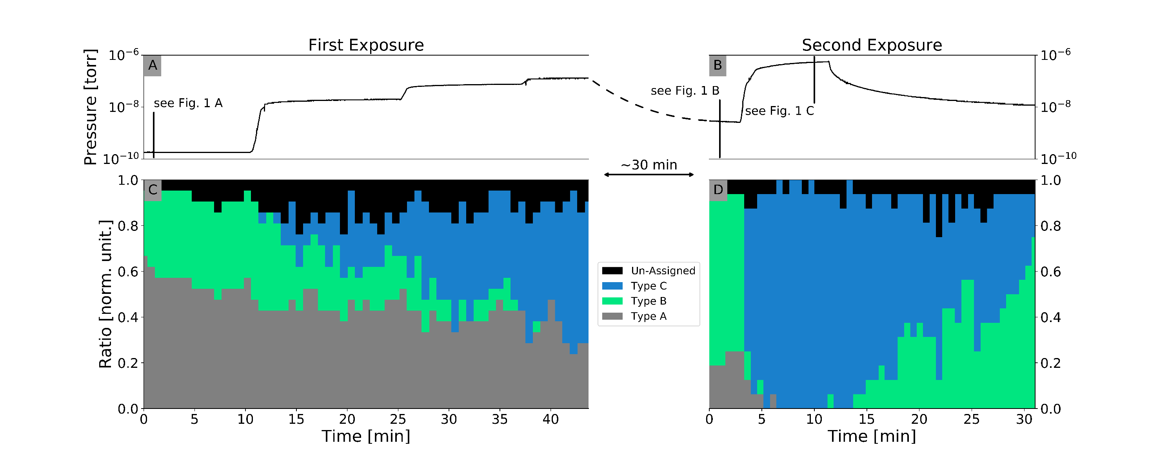
Figure 2, statistics
Figure 2:
Distributions between observed structures(type A,B and C). This figure consist of two in situ experiment in succession, where water was exposure to the vanadia covered a-TiO₂ (101) surface.(Estimated coverage ~2%)
In situ pressure measurement, measured during suppl. Movie 1.
In situ pressure measurement, measured during suppl. Movie 2.
The distribution between the three observed species during water exposure, the Type A (grey), the Type B (green) and the type C (blue) from suppl. Movie 1. the first water exposure directly after deposition. (structures are shown in figure 3)
The distribution between the three observed species during water exposure from suppl. Movie 2, the second exposure of water.
Black lines in part A and B indicate record time of figures 1A,B and C.

Slide 4
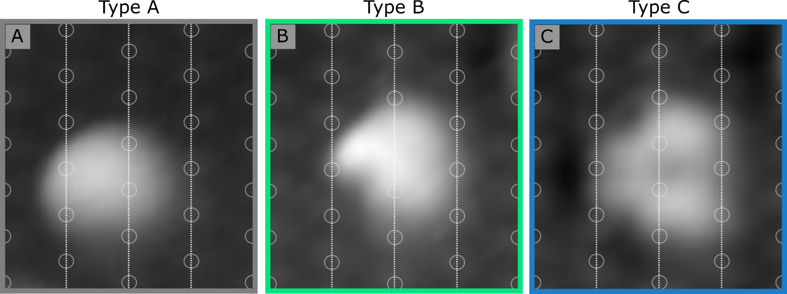
Figure 3, individual structures
Figure 3:
High resolution STM images of a vanadia features: before, after and during water exposure. A) High resolution STM image of the most common oval-shaped feature, V₂O₅ structure, found before water exposure. It extents across two Ti-5f–rows (vertical white guide-lines) and is centered between two Ti-5f – sites (grey circles)
B) High resolution STM image of the most common feature after water exposure, a 2 × VO₃H structure. It extents across two Ti-5f–rows, where the left part consists of one smaller protrusion on-top of the Ti-6f site. The right part consists of a larger protrusion also centered on top of the Ti-6f site.
C) STM image of the dehydrated structure. The right part consists of two larger protrusions centered on top of the Ti-6f site. It extents across two Ti-5f–rows. Notice the symmetry plane which lays in the horizontal plane which divides the particle in half.

Slide 5
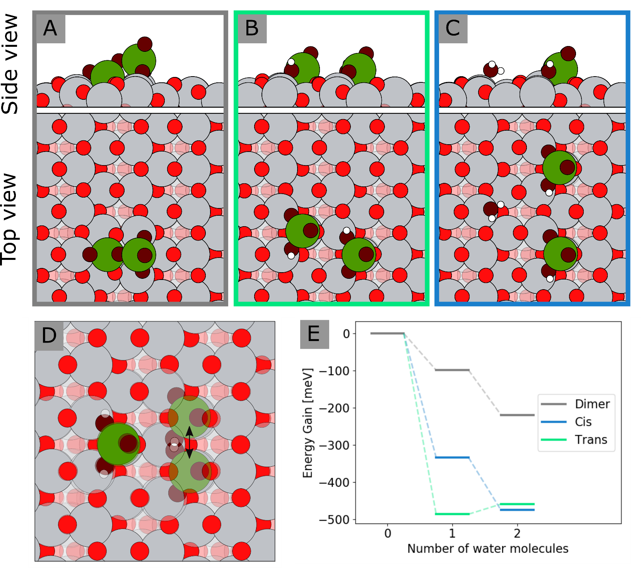
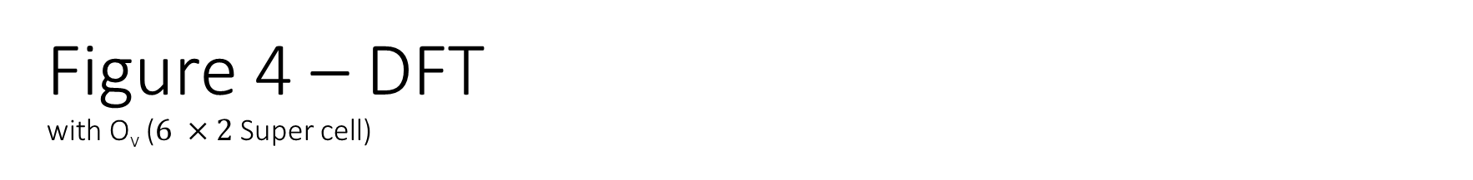
Figure 4 – DFT with O_{v} ($6 ×2$ Super cell)
Figure 4:
DFT results:
A side- and top-view of the “best fitting” structure for the type A structure. A V₂0₅ – structure on the a-TiO₂ (101) surface. This structure was found to be the global minimum.
A side- and top-view of the “best fitting” structure for the type B structure (after water exposure). These calculation includes V₂0₅ + 1 x H₂O. In the global optimum search two low energy candidates where found. The structure shown is the one that resembles the STM images the best and is also the global minimum.
A side- and top-view of the “best fitting” structure for the type C structure (during water exposure). These calculation includes V₂0₅ + 2 x H₂O. In the global optimum search three low energy candidates where found. The structure shown is the one that resembles the STM images the best, however not the global minimum.
The two possible configurations for the structure in part B (type B) overlapped.
Energy diagram showing the energy gain from the addition of an interacting water molecule.

Slide 6
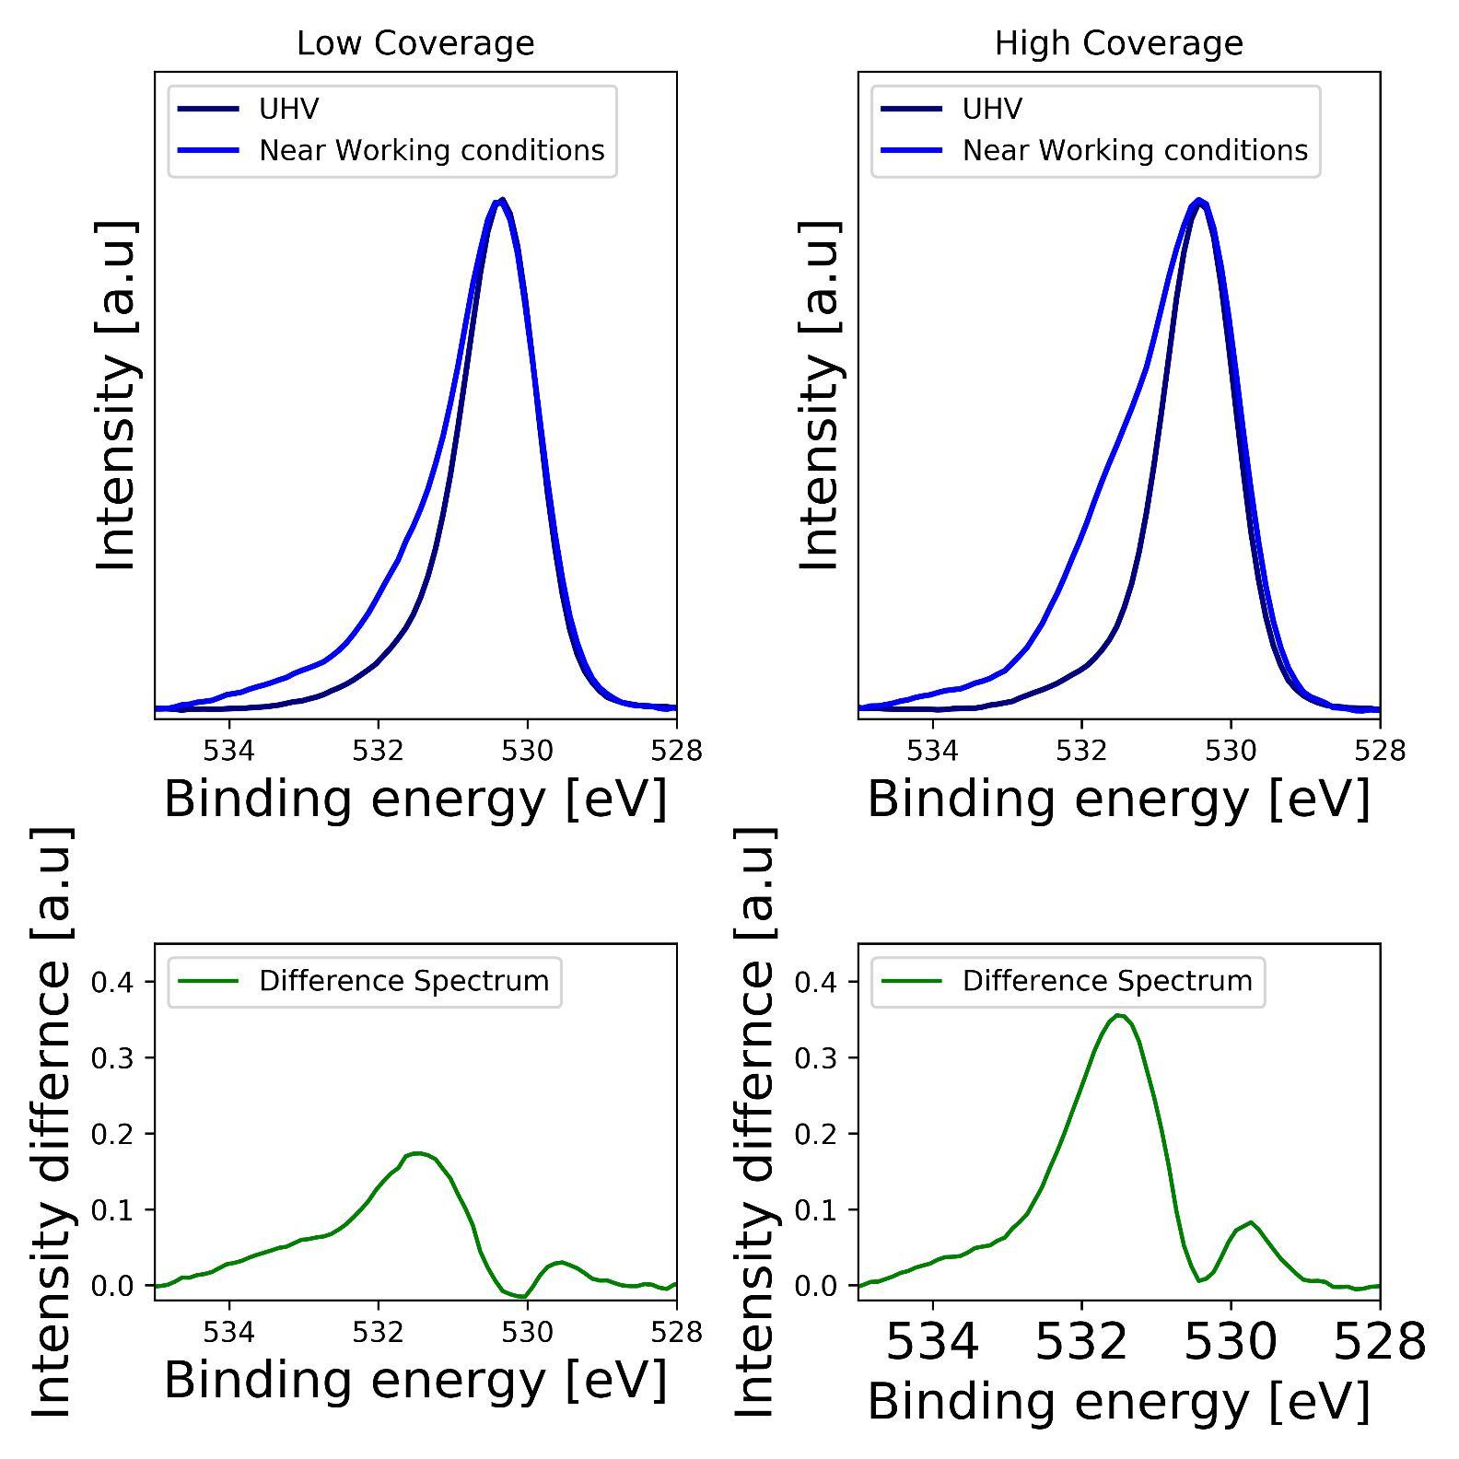
Supplementary figure 1
Near Ambient Pressure (NAP) – xps measurements of the O1s- peak.
Darkblue: UHV-conditions.
Blue : at 0.6 mbar total pressure (0.5 mbar H2O, 0.05mbar NH3 and 0.05 mbar of NO)

Slide 7
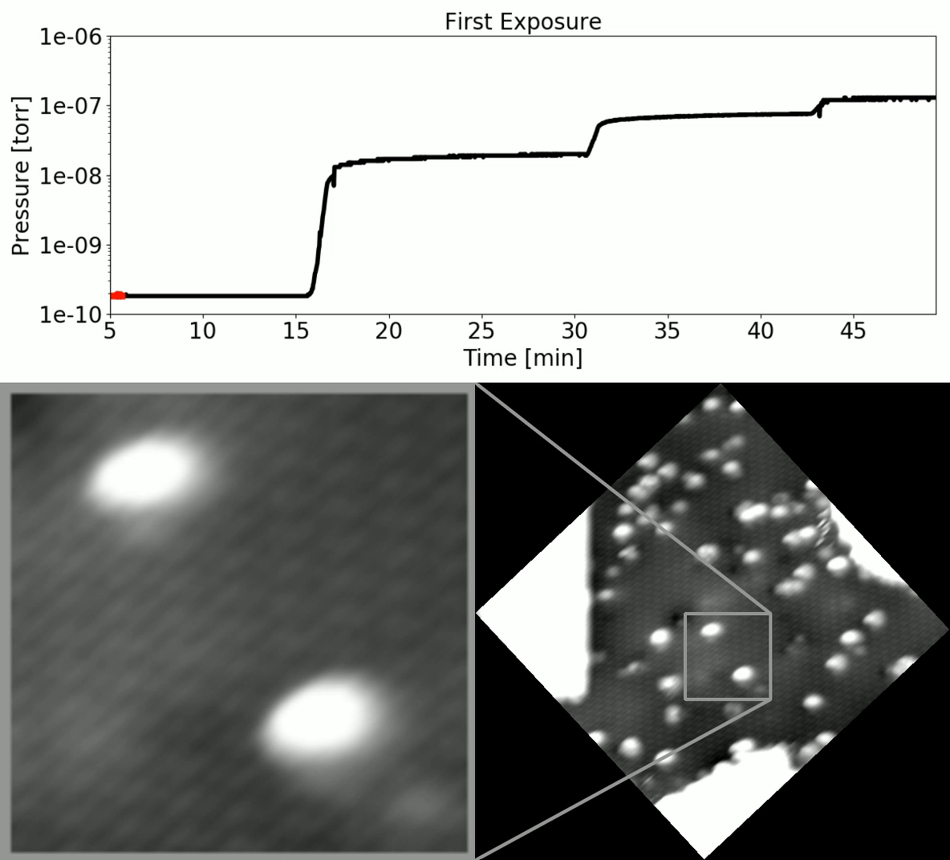
Supplementary movie 1

Slide 8
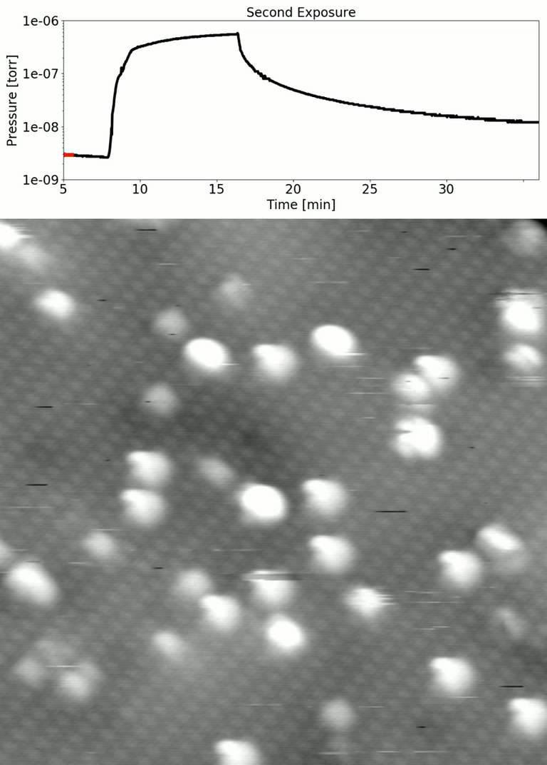
Supplementary movie 2

